Slide 1

Recipe Web Crawler
Hunter Smith, Isaac Watts, Kiara Wilson & Taniyah Epps

Slide 2

Project Overview
The Distributed Web Crawler is a system being designed to efficiently fetch and process web pages. The web crawler should pull recipes for people located in food deserts. The purpose of building this app is to show the use of using Multiprocessing, Multithreading, and Interprocess (and node) communication to create an efficient run-time program. The data gained will be analyzed and summarized for use.

Slide 3
Features
Parallel Page Fetching (Multiprocessing).
Concurrent Link Extraction (Multithreading).
A master node will assign URLs to worker nodes (Task Distribution).
Worker nodes will share results using queues or shared memory (IPC).
Nodes Share Results to each other (Internode Communication).
Multiple machines work together to crawl (Distributed Crawling).
System can resume crawling if a node crashes (Failure Recovery).
Worker Nodes can be added to improve performance (Scalability).
Web Page with Data Summary or Analytics

Slide 4
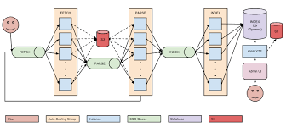
Controller
Purpose: Coordinates a distributed web crawling system by managing URL distribution and collecting results from worker clients.
Main Components: - Flask Web Server (Port 8000): • Serves static pages and provides API endpoints - Worker Communication Server (Port 5000): • Accepts TCP connections, assigns URLs, processes results
Data Management: - url_queue: Queue of URLs to crawl - visited_urls: Tracks already crawled URLs - queued_urls: Prevents duplicate work - queue_lock: Ensures thread-safe access
Key Features: - Multithreaded: Handles multiple workers - Dynamic URL Seeding: Enables search-based injections - Scalable & Modular: Easy to extend with more functionality

Slide 5
Worker Management and Coordination
Purpose: Coordinates with distributed workers to assign crawling tasks and receive results.
Worker Communication: - Listens for incoming worker connections via socket on port 5000 - Handles worker threads independently to process tasks in parallel - Protocol messages: MSG_READY, MSG_URL, MSG_RESULT, MSG_NO_MORE_WORK
Workflow: 1. Worker connects and sends MSG_READY 2. Server checks queue and responds with MSG_URL or MSG_NO_MORE_WORK 3. Worker sends MSG_RESULT with extracted links 4. Server adds new links back to queue if not visited or queued

Slide 6
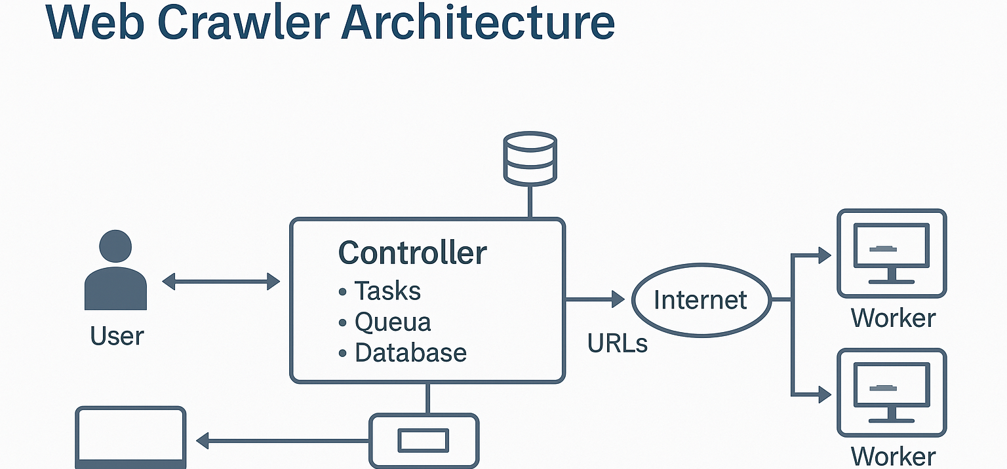

Slide 7
Docker
Base Image
Instruction: FROM python:3.12
Purpose: Uses a lightweight official Python 3.12 image to build the container environment.
Working Directory
Instruction: WORKDIR /app
Purpose: Sets /app as the root directory for all subsequent commands in the container.
Environment Variable
Instruction: ENV CONTROLLER_HOST=127.0.0.1
Purpose: Defines a variable for use inside the container (can help with configuration).
Copy Files
Instruction: COPY . /app
Purpose: Copies all files from your project into the container’s /app directory.
Install Dependencies
Instruction: RUN python -m pip install --no-cache-dir -r requirements.txt
Purpose: Installs Python packages listed in requirements.txt without saving cache, reducing image size.
Expose Port
Instruction: EXPOSE 80
Purpose: Informs Docker that the app inside the container will use port 80 (can be mapped to 8000 outside).

Slide 8

Docker EXAMPLE

Slide 9
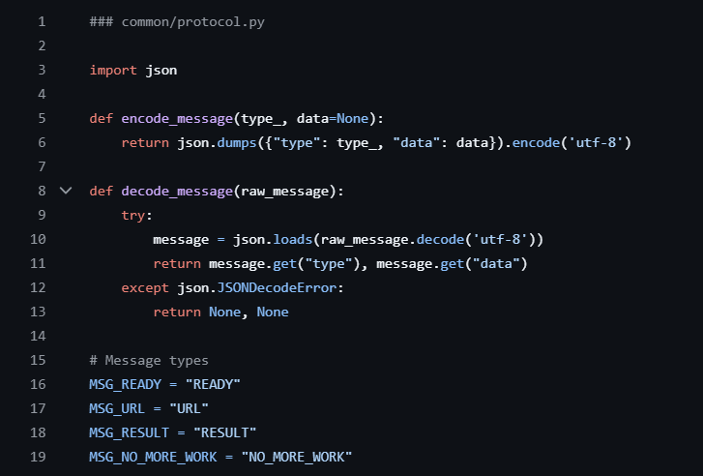
PROTOCOL
Purpose: Facilitates structured communication between the controller and worker nodes in the distributed web crawler.
Core Functions:
encode_message(type_, data=None) Converts a message (type + optional data) into a UTF-8 encoded JSON string for transmission over sockets.
decode_message(raw_message) Decodes a received JSON message from UTF-8 bytes into a Python dictionary. Handles invalid messages safely.
Defined Message Types:
MSG_READY → Worker is ready for a task
MSG_URL → Controller sends a URL to crawl
MSG_RESULT → Worker sends back extracted links
MSG_NO_MORE_WORK → Controller signals no more work is available

Slide 10
Database Integration with SQL
Purpose: Handles persistent storage of crawled recipe data using a PostgreSQL database.
Main Components: - Uses psycopg2 for PostgreSQL connection - Uses dotenv to manage credentials securely via environment variables
Functions: - `get_connection()`: Establishes DB connection using .env credentials - `create_table()`: Ensures `recipes` table exists - `insert_or_update_recipe()`: Adds or updates recipes by URL - `read_recipe(url)`: Retrieves recipe data by URL
Table Schema: - url (TEXT, PRIMARY KEY) - recipe_data (TEXT) - last_crawled (TIMESTAMP)

Slide 11
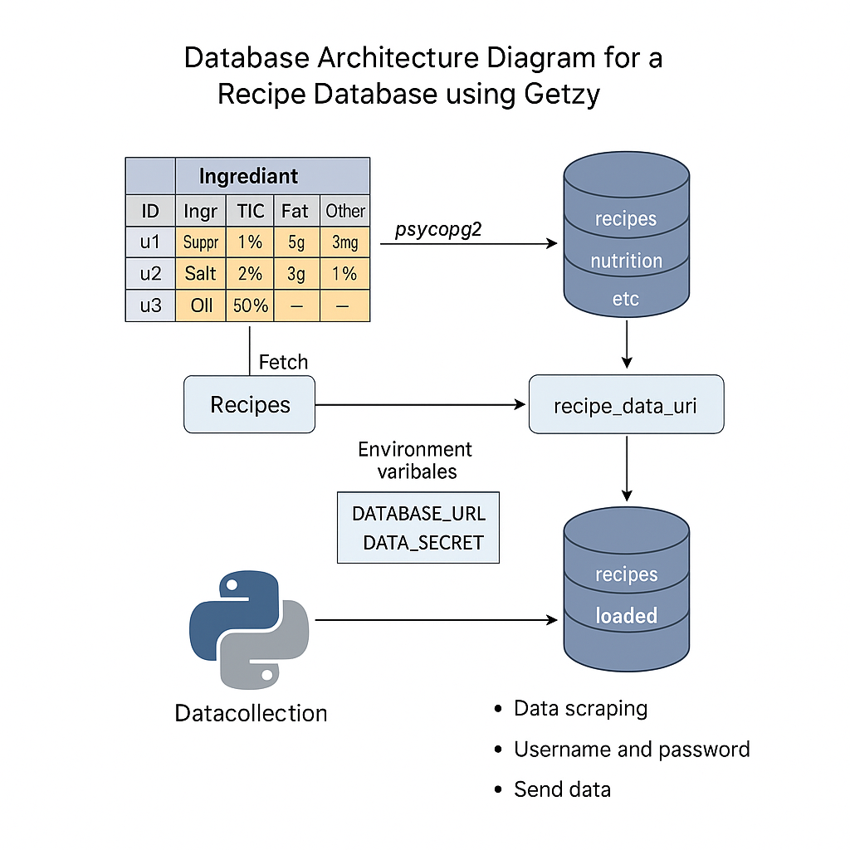
Database ARCHITECTURE

Slide 12
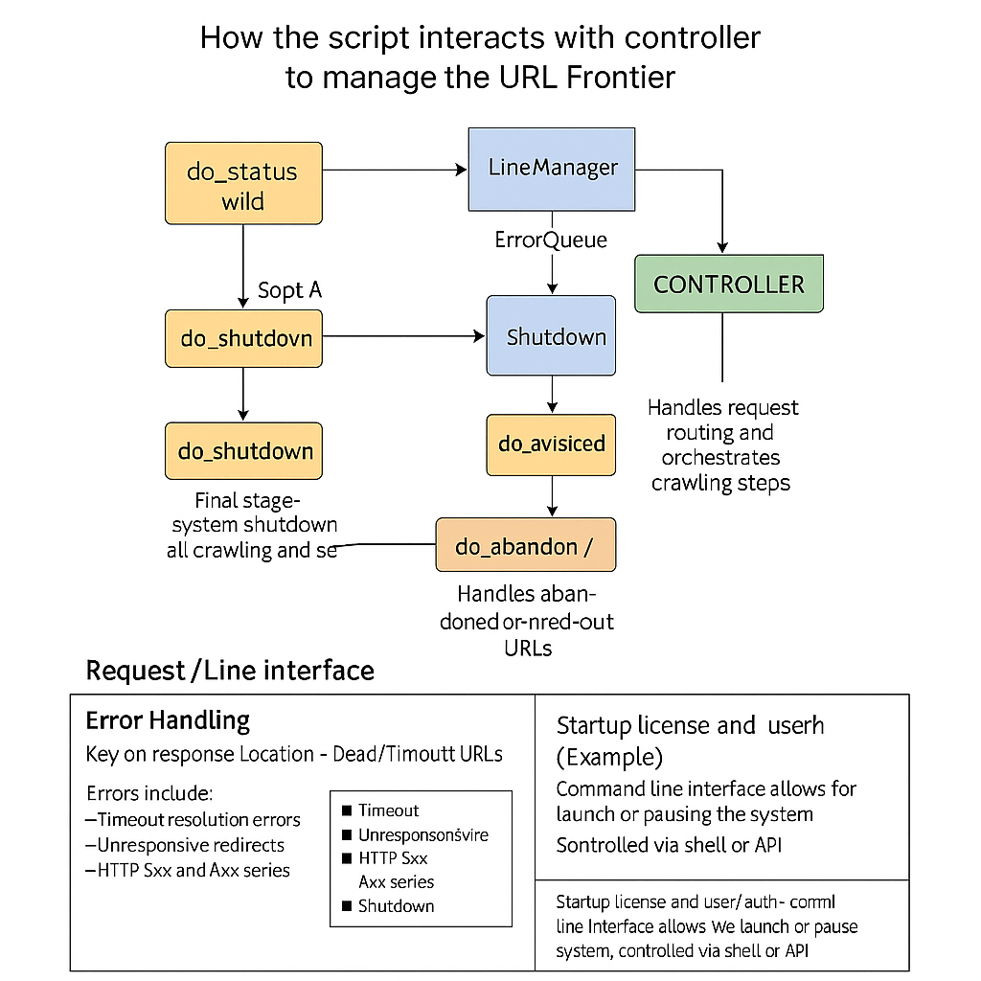
client
Purpose
A command-line client to interact with a web-based URL crawler controller running at http://127.0.0.1:8000.
Key Components
do_status() → Sends a GET request to /status and prints queue/visited info.
do_add(url) → Sends a POST request to /add_url with a URL to crawl.
do_visited() → Retrieves and prints all visited URLs from the /visited endpoint.
do_shutdown() → Sends a POST to /shutdown to stop the controller.
How to Use
bash
python client.py status python client.py add http://example.com python client.py visited python client.py shutdown
Error Handling
Uses raise_for_status() to detect HTTP errors.
Gracefully prints and exits on request errors or bad commands.

Slide 13
References
What Is a Web Crawler? | How Web Spiders Work | Cloudflare, www.cloudflare.com/learning/bots/what-is-a-web-crawler/. Accessed 26 Feb. 2025.
“What Is a Webcrawler and Where Is It Used?” GeeksforGeeks, GeeksforGeeks, 3 Oct. 2022, www.geeksforgeeks.org/what-is-a-webcrawler-and-where-is-it-used/.
“What Is a Web Crawler?: A Comprehensive Web Crawling Guide.” Elastic, www.elastic.co/what-is/web-crawler. Accessed 26 Feb. 2025.
Gillis, Alexander S. “What Is a Web Crawler? Everything You Need to Know from Techtarget.Com.” WhatIs, TechTarget, 30 Sept. 2022, www.techtarget.com/.

Slide 14
DEMO

